Slide 1
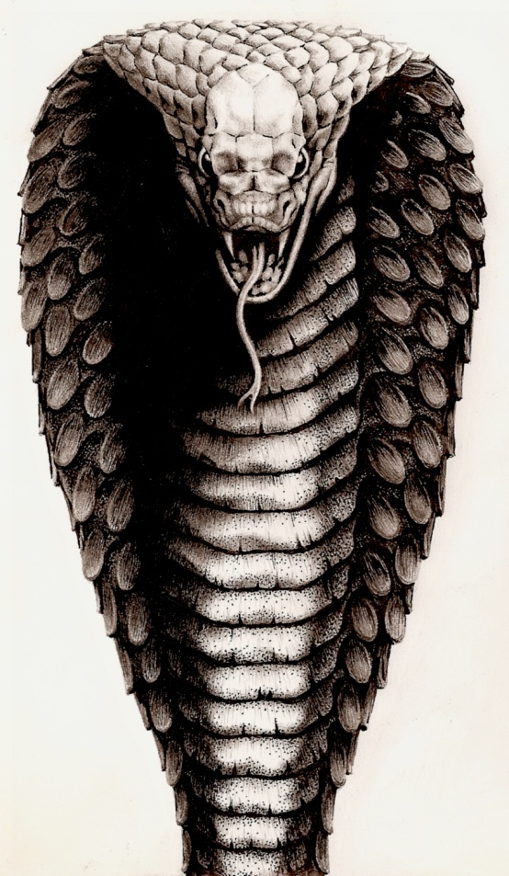
The Sneaky and Very Creepy King Cobra
By: Devin Arnold

Slide 2
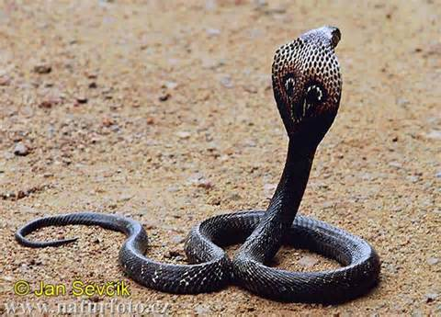
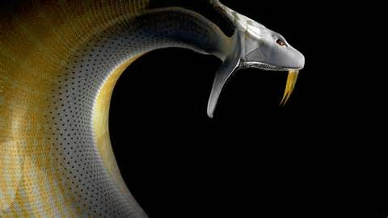
General Information-
My animal fits into the reptile group.
The King Cobra’s scientific name is Ophiophagus Hannah.
King Cobra’s life span is 20 years on average.

Slide 3
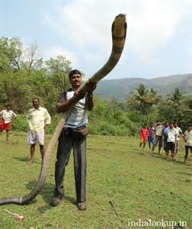
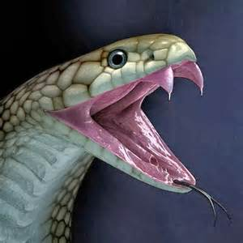
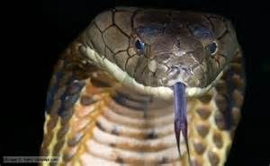
Physical Characteristics-
The head is brown and tan-ish and the body is tan-ish with brown polka dots.
The length is 13.2feet on average but the longest is 16feet! The weight is 12-17.6pounds.
My snake has a skin covering.
It has fangs which pushes the prey in its mouth and injects venom into its prey’s body.

Slide 4
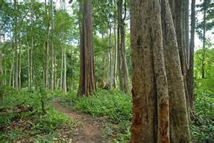
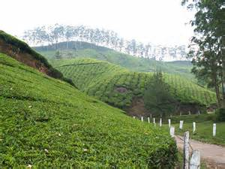
Habitat-
This snake lives mainly in Southeast Asia. Its clearings are bamboo thickets and the edge/border of forest.
It is tropical and very wet.

Slide 5
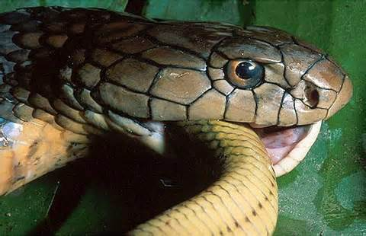
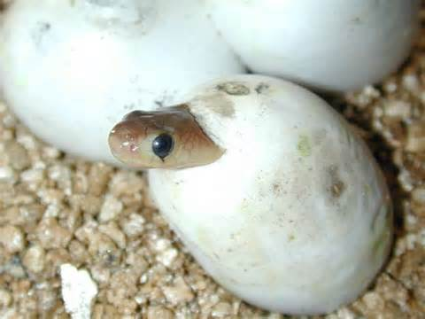
Behaviors-
My animal eats on other snakes and sometimes lizards.
It does a sneak attack. It sneaks up on its prey and it bites its neck and then swallows them. To find its food it sticks its tongue out and smells the air for other food/prey.
The King Cobra lays eggs.
My snake can have 18-51 babies. Usually it has 40-50 babies at a time.

Slide 6
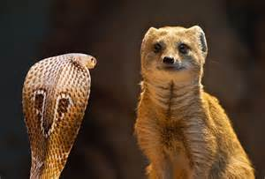
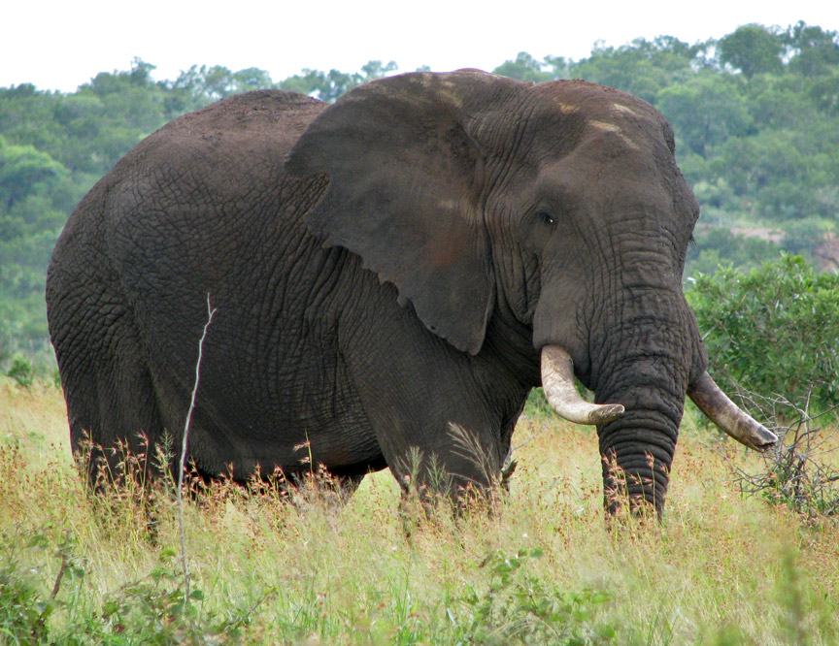
Interesting Facts-
The King Cobra’s generic name is snake eater.
The cat sized mongoose can survive the King Cobra’s venom
The King Cobra’s bite is so poisonous that it can kill an elephant.

